Slide 1


Stack Organization (Register Stack) Session No.: 15 Course Name: Computer Organization and Architecture Course Code: R1UC305T Instructor Name: Mr. Piyoush Kumar Duration: 50 Min. Date of Conduction of Class:

Slide 2
Learning Outcome
Explain stack operations for the register stack and how stack organization affects instruction execution and subroutine handling.
Apply stack concepts to real-world and advanced contexts.

Slide 3
Session Outline
1 Introduction to Stack Organization
2 Types of stack organization
3 Register Stack Operations and its applications
4 Activity (Think Pair Share)
5 Activity (Hands-on)
6 Conclusion

Slide 4
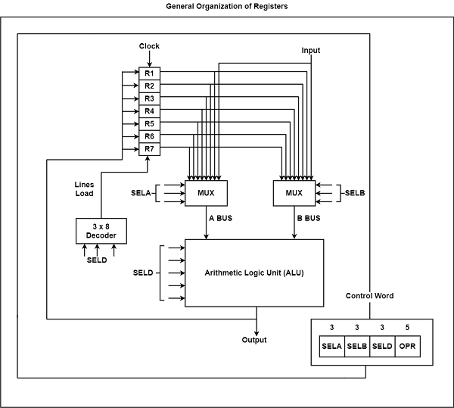
Recap
What should be the size of the decoder and multiplexer?
What is a control word?

Slide 5
Open Question:
* How Stack works ???

Slide 6
Introduction to Stack Organization
Stack: Based on the LIFO Principle
Real Life Analogy ( Stack of Plates)
Basic Operations: Push and Pop
Stack Pointer
Role of stack in a computer system:
Subroutine (function) calls
Expression evaluation
Interrupt handling
Recursive functions

Slide 7
Types of Stack Organization
Register Stack
Inside CPU-High speed registers
Limited size ( up to 32 registers), fast speed
Used in old architecture and modern RISC processors
Memory Stack
Implemented in main memory
Stack Pointer: Stores the address of the top of the stack
Stack can grow up to the memory size
Slower access because memory operations take more cycles.

Slide 8
Register Stack Operations
Components of register stack:
Stack memory (Set of Registers)
Stack Pointers (SP-Point to top element of the stack)
Control logic (PUSH, POP, Underflow, Overflow)
Status Bits: Full and Empty
Operations:
PUSH X
If Full == 1 → Overflow (cannot insert new element).
If not full → increment SP, place new element X in top register.
POP X
If Empty == 1 → Underflow (cannot delete).
If not empty → take value from SP, decrement SP.

Slide 9
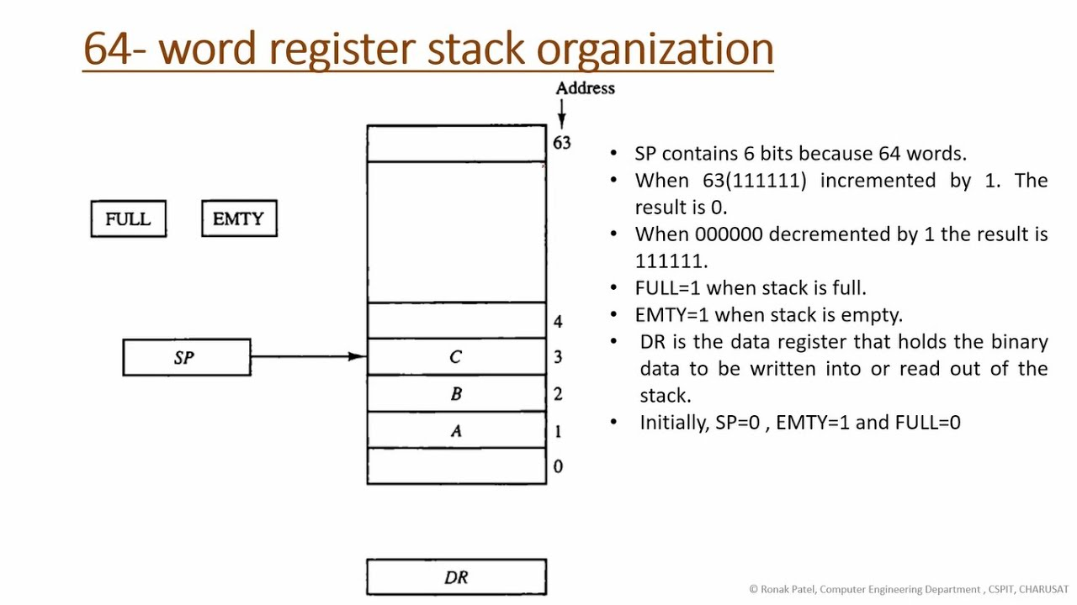
Register Stack Operations

Slide 10
Advantages and Disadvantages
Advantages:
Very fast (registers are inside CPU).
No need to access slower memory.
Useful for temporary storage in arithmetic operations.
Disadvantages:
Limited number of registers.
Expensive implementation (as registers are costly).

Slide 11
Applications
1. Arithmetic Expression Evaluation
Infix → Postfix conversion and evaluation.
Example: (A + B) * (C – D)
Postfix: AB+CD-*
Computed using stack PUSH/POP.
2. Function/Subroutine Calls
When a function is called:
Return address is PUSHed onto the stack.
Local variables may also be stored.
When function ends:
Return address is POPped from the stack.
3. Recursion
Each recursive call pushes a new stack frame (local variables + return address).
Stack grows with each call, shrinks with each return.
4. Interrupt Handling
On an interrupt: CPU saves Program Counter (PC) + status registers onto stack.
After servicing, CPU POPs them back to resume program execution.

Slide 12
Activity-1(Think Pair Share)
Work in groups to trace
Push-Pop operations and the role of the stack pointer in the register stack.
.

Slide 13
Activity-2(Hands-on)
Qus: A computer uses register stack organization with the following registers:
SP = 1000 (initially points to address 1000)
Stack grows downward (decrement SP on push, increment SP on pop).
Each word = 2 bytes.
Perform the following sequence of operations:
PUSH 25
PUSH 30
POP
PUSH 40
Find:
Final stack pointer (SP) value.
Final contents of stack top.
.

Slide 14
Summary
Stack organization follows the LIFO (Last-In, First-Out) principle, utilizing a stack pointer (SP) to manage push and pop operations.
Stacks are classified as ascending/descending and full/empty based on address growth and SP usage.
Register stack uses CPU registers arranged as a stack, enabling fast expression evaluation and procedure calls.
.

Slide 15

Post Session Activity –
Share this link: https://app.wooflash.com/moodle/CU4IIG6P
Share this code: CU4IIG6P
QR code:

Slide 16

Review and Reflection from students
Qus: Evaluate the following expression by using a stack-
(3 * 4) + (5 * 6)

Slide 17
Thanks

